Slide 1
AI-Assisted Competency Modeling
and Automated Alignment to Learning Resources
NORDEFCO Learning Technologies Conference | April 2026
Brent Smith | Sara Rahgooy

Slide 2
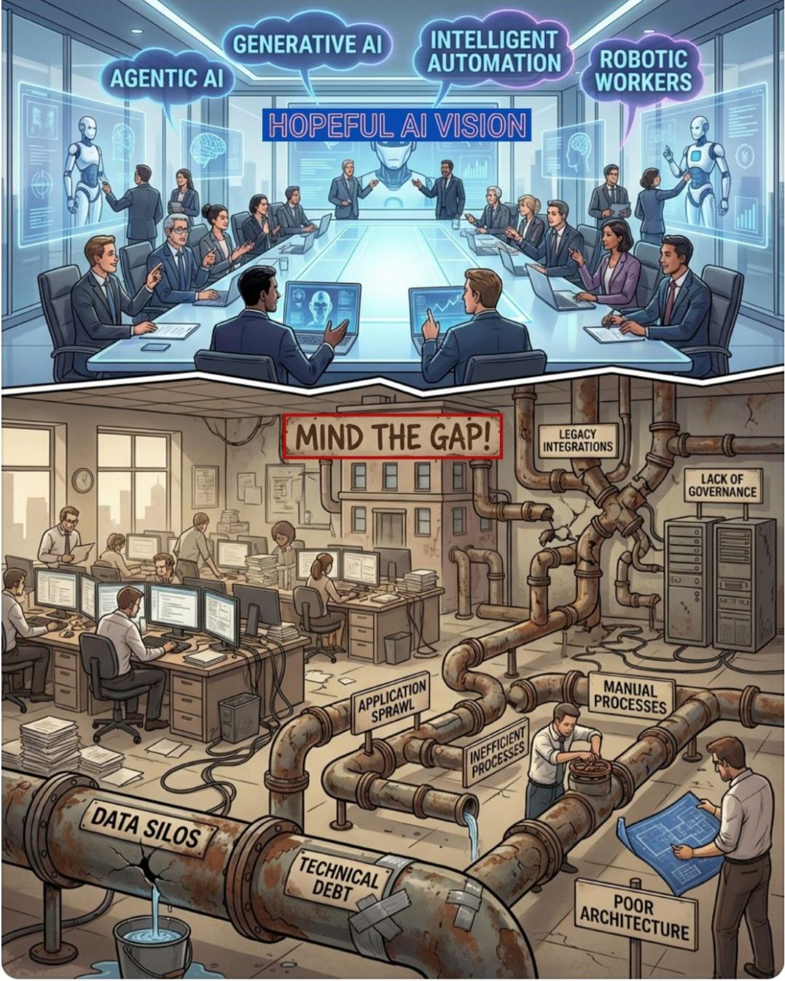
Agenda
The ADL Initiative & Total Learning Architecture
The problem: why traditional competency frameworks fall short
The DCWF: structure, work roles, and KSATs
IEEE 1484.20.3: Standard for Sharable Competency Definitions
The solution: the DCWF Competency Graph in Neo4j
What atomic competencies are and why they matter
Breaking down a KSAT: the encryption example
The I/O psychology foundation behind our approach
AI-assisted generation: how we produce 18,000+ competencies
Human-in-the-loop validation: keeping quality high at scale
Questions Welcome Throughout. This is a Conversation, not just a Presentation
Notes:
CLS Principals include the leadership / staff of the ADL Initiative for Engineering, Human-Centered Design, Specifications / Standards, and Program Management
ADL developed the Total Learning Architecture to enable an interoperable, DoD-wide, Learning Ecosystem
The team prides itself on being blue collar engineers where all of us where many hats and do whatever it takes to get the job done.

Slide 3
ADL Initiative (1998 – 2025) – Rest in Peace
SCORM
xAPI
Total Learning Architecture
1999–2004
2013–present
2017–present
Standardized how learning content is packaged and tracked inside an LMS. First DoD-wide interoperability standard for e-learning.
Extended tracking beyond the LMS to any learning environment — simulations, mobile, on-the-job. DoD adopted it across all Services.
A blueprint for a connected learning ecosystem where competency data, learner records, and content communicate across platforms in near real-time.
ADL was a U.S. government-let initiative advancing digital learning standards, architecture, and interoperability across training, education, and professional development
Although sponsored by DoD, ADL served global partners including government, academia, and industry
ADL contributions included:
  NATO education and training modernization, including the integration of ADL into NATO exercises
  Informed NATO’s ADL STANAG
  Led the Global Partnership Network spanning international defense ministries and allied organizations
  Enabled interoperability across nations, systems, and learning providers.
ADL enabled nations and organizations to share learning and data without sharing systems

Slide 4
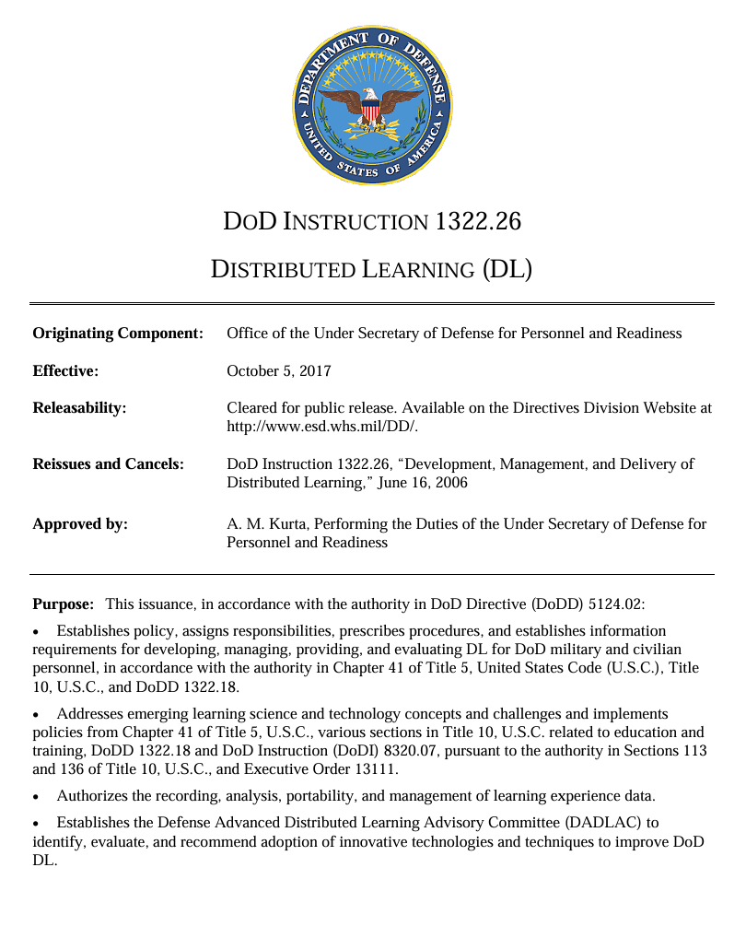
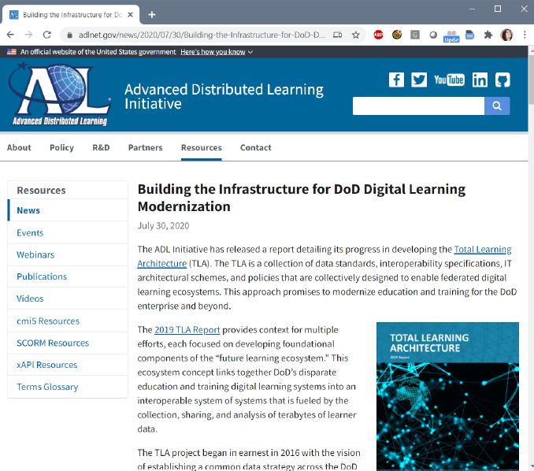
ADL Legacy and Technical Lineage
CLS is built on the same architectural expertise that shaped DoD’s learning‑data modernization. Our team:
Served as the core architects for the Total Learning Architecture (TLA Study Group | Understand the Total Learning Architecture)
Developed and sustained OpenLXP – DoD’s open-source learning experience platform (Previously deployed as the DoD Learning Enclave)
Contributed to IEEE and emerging DoD standards (DoD Instruction 1322.26) and enabled a training and education data strategy aligned with the DoD Data Strategy (DOD Data Strategy)
Supported Digital Transformation programs for training, education, and professional development across Army, Navy, USMC, Air Force, and Joint Staff. Support DoD’s Software Modernization Implementation Plan for FY25-26.
TLA Standards are Used Across the Services, Industry, and Government
Notes:
DoDI 1322.26 governs the use of digital learning data across DoD
Includes Acquisition and Implementation Guidance for utilizing IT systems that meet IEEE's Interoperability Standards
Enables DoD-wide interoperability by connecting authoritative sources of learner data to the ECC, ECCR, and ELRR
Provides guidance on how DoD's training and education community should leverage enterprise data to optimize operational efficiency
IEEE Data Standards
IEEE P2881 Learning Metadata Terms (LMT) to describe training, education, and professional development resources
IEEE Sharable Competency Definitions (Frameworks) to describe labor frameworks, master competencies, KSATs, certifications, and other manpower requirements
IEEE Enterprise Learner Records describe the workforce by linking individual / organizational learner proficiency levels to mission objectives and readiness
IEEE XAPI 2.0 for system to system communication
While at ADL, CLS staff supported:
Navy Ready Relevant Learning / ASN-M&RA / NAWCTSD
Army University / ATIS / STEEL-R
DAF Learner Record / AETC / CFETP / Air University
USMC University / Marine Net

Slide 5


TLA: Enterprise Interoperability Through IEEE Standards
Enterprise Learner Records (IEEE P2997)
Human Performance (IEEE 9274.1 xAPI)
    Learner Records
    (e.g., Longitudinal Records of Performance)
    Catalog of Learning Experiences
    (Inventory of Available Learning Resources and Events)
Descriptive Metadata (IEEE P2881)
Teaches / Assesses / Aligns to
Competencies
(Knowledge, Skills, Abilities, Tasks, and Other Behaviors)
Sharable Competency Definitions (IEEE 1484.20.3)
    Readiness Reporting
    (e.g., Mandatory Training, Gap Analyses, Command & Control)
    Talent Management
    (e.g., Human Resource Management, Career Field Planning, Workforce Planning)
Worldwide Learning Resources
Notes:
Data interoperability is enabled through the use of IEEE standards
Learning Resources are described and cataloged using P2881 Standard for Learning Metadata Terms
Competencies and KSATs are described using SCDs
Learner Performance is captured using xAPI
The aggregation of that data over time, supports Talent Management
Supports Individual, Self-Regulated Learning to keep employees engaged.
Promotes mobility and retention by making resources available for professional development and career progression.
Supports Career Field Management and Improved linkages to Individual Development Plans

Slide 6
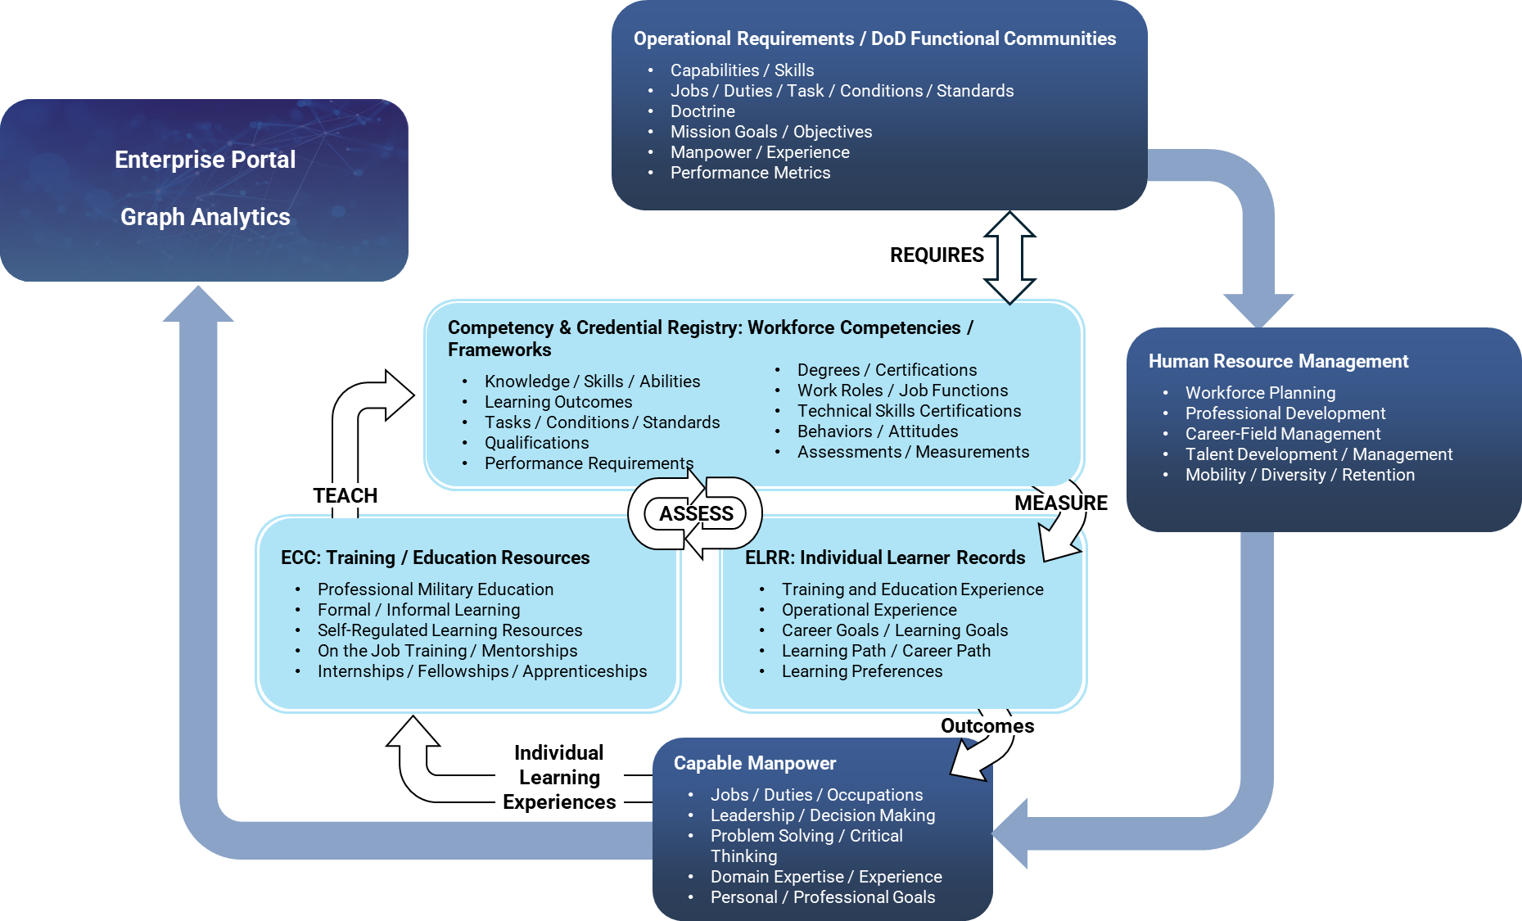
OpenLXP is the Core Data Infrastructure for TLA
OpenLXP is an open-source platform originally developed through the ADL Initiative
OpenLXP modernizes how organizations discover, manage, and connect learning resources
Built on open standards and modular architecture, OpenLXP integrates seamlessly with existing LMSs, LRSs, HRIS systems, and content providers.
Provides a flexible foundation for enterprise learning ecosystems, enabling interoperability, data portability, and vendor‑agnostic innovation.
CLS has been a core technical contributor to OpenLXP since its inception

Slide 7
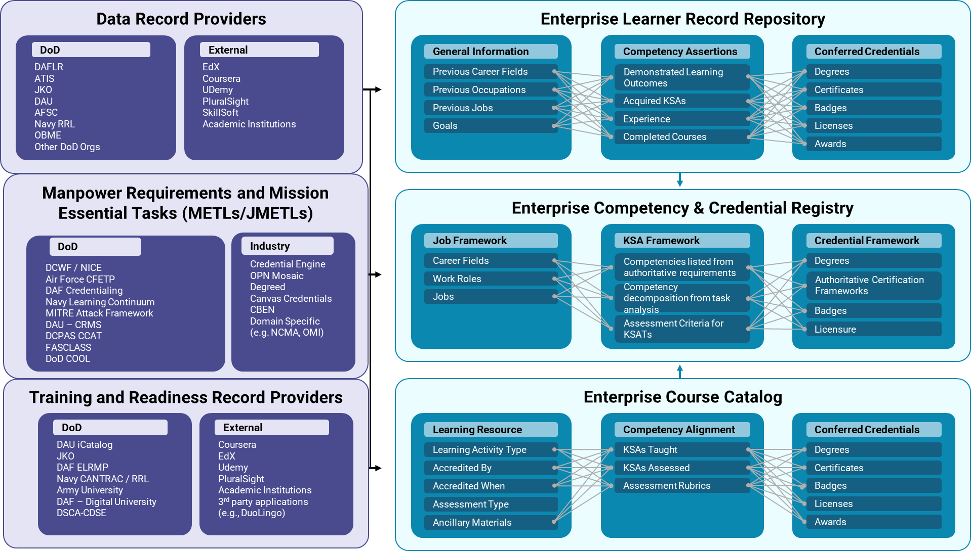
OpenLXP Ingests Data from Inside and Outside an Organization
DAF Learner Record
ATIS
JKO
DAU
PCTE
Service Schools
DCWF
Joint Qualification Records
DAF CFETP / DAF Credentialing
COOL / MilGears
Navy MRCs
CCAT
NIST NICE 3.0
MITRE ATT&CK
Degreed
OPM Mosaic
CBEN
Canvas Credentials
JKO Course Catalog
Navy CANTRAC
Army University
DAF Digital University
CDSE
DAU iCatalog
Notes:
Each of the EDLM Data Services includes a range of different information that is collected from both DoD Systems and Systems that are external to DoD.
Each of these systems works as a ‘dot-connector’ for all the data being managed by that standard.
This is one of the journey maps we’ve been building out with Sandra and Gustavo to show how a learner / job seeker might be able to use the data contained within EDLM to find new, higher paying job opportunities within the DoD.

Slide 8
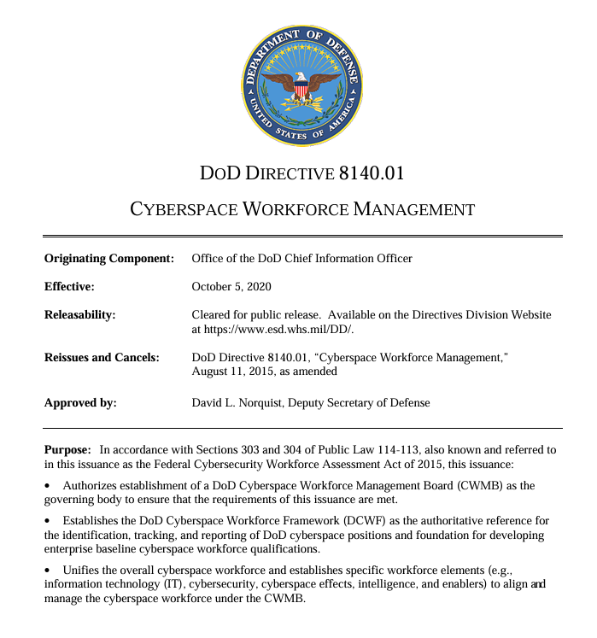

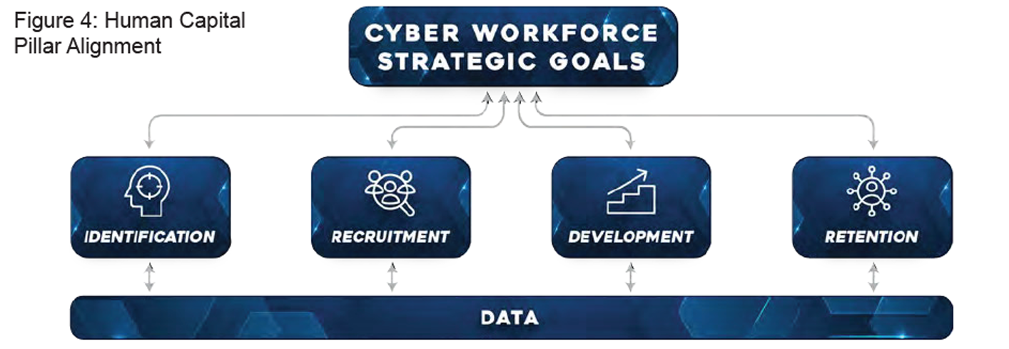
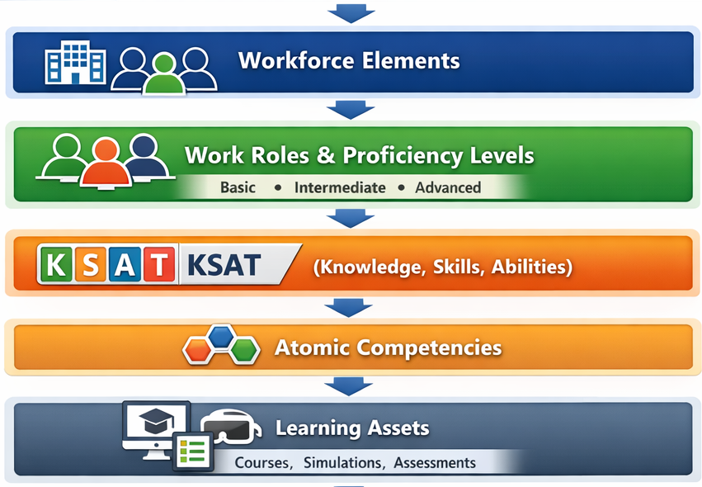
Managing DoD’s Cyber Workforce
DoD Directive 8140 is the policy for managing the cyber workforce across civilian, military, and contractor populations
8140 Defines
Who is part of the cyber workforce
How cyber work is identified and categorized
How personnel qualification, readiness, and development are governed
How Components align to a common Department-wide approach
8140 helps ensure the cyber workforce is
Ready for current missions
Adaptable to future threats
Managed consistently across DoD
8140 provides the authoritative policy foundation that enables standardized tracking, qualification, and development of the DoD cyber workforce

Slide 9

DoD Cyber Workforce Framework (DCWF)
The DCWF is the Department’s authoritative taxonomy for describing Cyber Work
Workforce Elements
Work Roles (72 work roles)
Uniform
Identification
Cyber
Work Roles
KSATs (3,124 entries)
Data
Collection
Tracking
Applies across Military, Civilian, and Contractor Populations
Each DCWF Work Role includes
  A unique ID
  A Clear Definition
  Required Knowledge, Skills, Abilities, and Tasks (KSATs).
DoD Cyber Work role
Qualifications
DCWF defines work based on what people do, not job titles or organizational structures

Slide 10
The Challenge: Competency Frameworks Under Pressure
Frameworks that cannot keep pace with the field become obstacles, not tools
⏱
📋
Too Slow to Update
Too Abstract to Use
🔗
Not Connected to Learning
Traditional competency modeling relies on months of expert meetings, formal review cycles, and manual revisions. This delays responsiveness to evolving mission and workforce demands.
Inconsistent metadata and vocabularies across multiple frameworks degrade AI-enabled recommendations. No standardize identifiers between different competency frameworks
Fragmented ownership and ineffective governance slow competency framework updates and create months-long delays between authoritative changes and delivered training.
High-level competency statements don't translate into training content, skills assessments, or proficiency measurements without significant additional interpretation.
Distributed learning data prevents enterprise insights into progress and readiness. External providers and legacy IT systems use incompatible metadata and schemas
Many frameworks use competencies that are intentionally broad. The describe what a person should know, not how deeply they must know it or how to measure it
Competency frameworks typically exist in documents or spreadsheets and are isolated from the learning assets, systems, and people they are supposed to guide.
Difficult to measure ROI or effectiveness of an organization’s investments in learning tools or content. Learning data cannot be linked to mission outcomes or readiness.
Learning activities not semantically connected to the mission, workforce goals, or enterprise outcomes they are meant to support. This creates a barrier to data-driven decision making
A Framework that took two years to develop may be partially out of date by the time its published
Notes:
For example: The DoD Cyber Workforce Framework provides a common lexicon of work roles and KSATs, but KSATs are intentionally broad. They describe what a cyber professional should know, not how deeply they must know it or how to measure that proficiency across Components.
KSATs lack granularity which makes it difficult to distinguish foundational awareness from operational mastery.
No standardized way to assess proficiency across Services, Components, or mission contexts
Leaders cannot reliably map training activities to actual capability because KSATs do not break down into measurable, observable skills.
Workforce readiness reporting remains higher level which limits the Department’s ability to identify gaps, forecast risk, or align training investments with mission needs.

Slide 11
DCWF Example: Work Role Differentiation
Example: Knowledge of Encryption Algorithms is a line item in the DCWF. Yet real proficiency spans multiple domains including cryptographic concepts, symmetric vs. asymmetric encryption, hashing, key management, PKI, protocols, tools, compliance, operational troubleshooting, and more.
KSAT K0025
Work Roles that Require this KSAT
"Knowledge of
Encryption
Algorithms"
1 Cyber Defense Analyst 9 DevSecOps Specialist
2 Security Architect 10 System Developer
3 Systems Security Analyst 11 Forensic Analyst
4 Systems Requirements Planner
5 Information Systems Security Manager
6 Information Systems Security Developer
7 Cyber Defense Forensics Analyst
8 COMSEC Manager
Required By
As written in the DCWF, this KSAT provides no guidance on scope, depth, or context. Yet it applies to different Work Roles across Basic, Intermediate, and Advanced levels — with no differentiation.
Four Words are not enough to teach, assess, and differentiate across the different Work Roles that require this KSAT

Slide 12
IEEE 1484.20.3 Standard for Shareable Competency Definitions
IEEE 1484.20.3 establishes a common data model for defining and sharing competency definitions across any system that implements the standard — regardless of vendor, platform, or organization.
🆔
Structured Identity
🔗
Explicit Relationships
🌐
Portability
Every competency carries a unique identifier, a human-readable description, and machine-readable metadata to enable precise referencing across systems.
Every competency includes a rubric for evaluating different levels of proficiency, versioning to document how the competency evolves over time, and a unique identifier
Competencies can be linked to other competencies and different competency frameworks, proficiency levels, or mission outcomes.
Clear linkages between competencies and frameworks supports traceability, such as connected learning resources or assessments, and enables scalable governance
A competency defined to this standard can be read, imported, and used by any compliant system such as an LMS, HR platform, analytics tool, or graph database.
Semantic interoperability preserves a common meaning across tools, enabling interoperability when different systems refer to the same competency definition.
CLS Implementation: Each node in the DCWF Competency Graph follows the IEEE 1484.20.3 data model. It includes a unique identifier, structured description, proficiency level, and explicit relationships to KSATs, Work Roles, and learning assets. The graph is not a closed or proprietary system. It is built on an open standard that any compliant system can use.
Notes:
IEEE 1484.20.3 represents the international consensus on how competency data should be structured. For NORDEFCO nations considering similar workforce frameworks, this standard is the foundation that enables interoperability. A competency defined by the U.S. using this standard can be understood and imported by a Norwegian or Finnish system that also follows the standard. That portability is what makes investment in competency modeling sustainable.

Slide 13
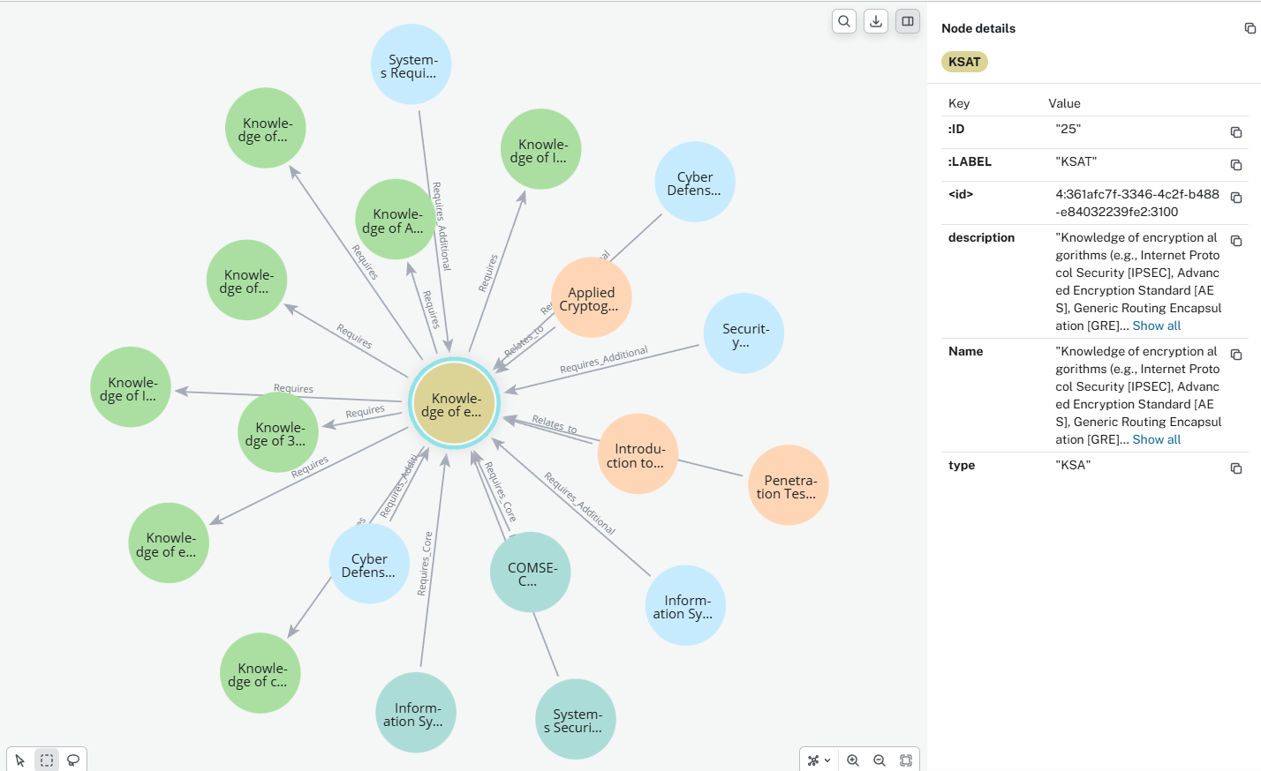
Cyber Workforce Solution: DCWF Competency Graph
Load the DCWF into a purpose-built graph database (Neo4J) and extend the hierarchy with a new layer of atomic level competencies
  Decompose each KSAT into its underlying skill elements
  Map every atomic competency to learning resources
  Assess proficiency at the skill level and roll up to KSATs / Work Roles
  Connect legacy systems and disparate data sources
  Enables enterprise analytics
KSATs define the mission requirements. Atomic Competencies deliver the assessment criteria and chain of evidence needed to measure proficiency.
Notes:
We’ve decomposed each KSAT so for Knowledge of Encryption Algorithms, you might have the following atomic level competencies.
- Symmetric vs. asymmetric encryption — which, and how deeply?
- Public Key Infrastructure (PKI) and certificate management?
- Troubleshooting failed certificate chains or misconfigurations?
- Selecting algorithms based on regulatory requirements?
- Auditing an organization's cryptographic posture?
Key management — generation, rotation, revocation?
Each can be weighted or tailored to different Work Roles – Not every Work Role will require the same level of proficiency

Slide 14
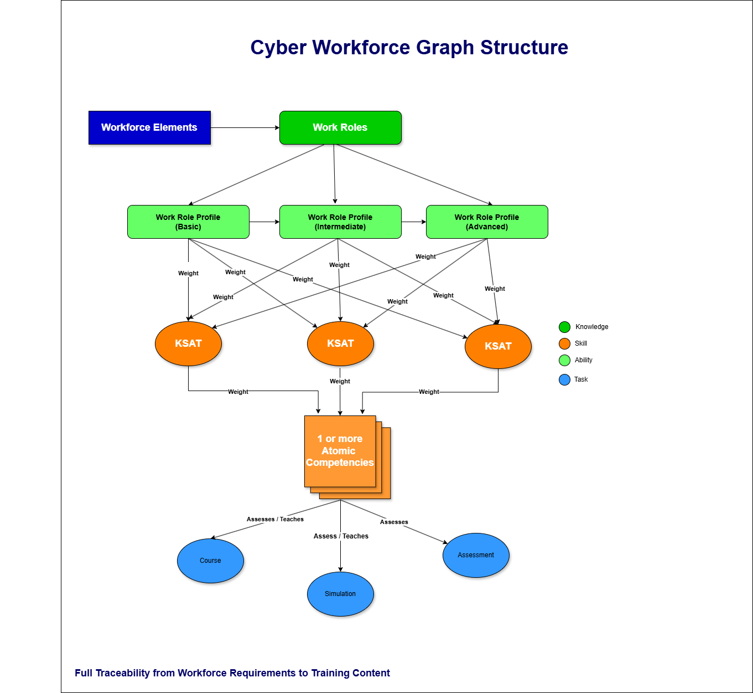
DCWF in Neo4J: Seeing the Relationships
What the graph enables:
⚖
Which competencies distinguish Basic from Advanced Cyber Defense Analyst?
🔁
Which KSATs are shared across the most Work Roles?
🎯
Which learning assets address the gap for a given role?
📡
What downstream content is affected if a KSAT is updated?
Neo4J allows us to query across all levels simultaneously. This is not possible with a spreadsheet

Slide 15
Competency Graph
Demonstration

Slide 16
AI-Assisted Competency Modeling
From KSATs to
Atomic Competencies
The science and process behind 18,000+ validated competency definitions

Slide 17
DCWF Competency Graph Enhancements
Workforce Elements
Work Roles (72 work roles)
(Basic · Intermediate · Advanced)
KSATs (3,124 entries)
NEW
Atomic Competencies (18,000+ → 32,000 projected)
NEW
Learning Assets (courses · simulations · assessments)
A Graph doesn’t just store competencies. It stores relationships

Slide 18
What are Atomic Competencies?
An atomic competency is the smallest unit of knowledge, skill, or ability that can be independently defined, taught, and assessed. Together, a set of atomic competencies constitutes a KSAT and provides the specific, measurable foundation that the KSAT's narrative description implies but does not define.
🔬
Specific
👁
Observable
📊
Calibrated
Each atomic competency targets one distinct knowledge area or skill behavior that can be taught in isolation.
It describes one thing to be learned or performed and avoids embedded sub-skills. It can be independently taught, updated, or retired without affecting unrelated competencies.
Its scope is narrow enough to support precise mapping to learning activities and assessments
The competency can be demonstrated through a measurable behavior or product, making assessment straightforward and defensible.
Performance evidence can be collected without subjective interpretation and evidence can be recorded as data. Observation does not require inference about intent.
Each competency supports repeatable assessments across individuals and contexts
Atomic competencies are aligned to a proficiency level (Basic, Intermediate, Advanced) and enable clear rubrics for evaluation.
Performance criteria are consistent across assessors and organizations. Proficiency alignment enables comparisons across roles, systems, and time.
Calibration supports differentiation between awareness, application, and mastery.
These three properties, combined with the job analysis rigor behind how they are defined, are what make atomic competencies usable for training design, gap analysis, and workforce planning.
Atomic competencies enable a specific, observable, and measurable rubric for each KSAT
Notes:
Explain that you came to this work from a psychometrics and I/O psychology background
This is important because competency definitions that are going to be used for assessment or hiring decisions need to meet a level of rigor that goes beyond just 'sounding right.' The term 'atomic' is borrowed from physics but the concept is straightforward: we're finding the smallest meaningful unit.

Slide 19
DCWF Example: Proficiency Differentiation
The “Knowledge of Encryption Algorithms” KSAT can now be calibrated differently for each work role AND proficiency level:
BASIC
INTERMEDIATE
ADVANCED
✓ Understanding of symmetric encryption (AES, 3DES) and appropriate use cases
✓ Understanding of asymmetric encryption (RSA, ECC) and its role in secure communications
✓ Can identify the purpose of encryption in a system context
✓ Awareness of common algorithms (AES, RSA) by name
✓ Knowledge of Public Key Infrastructure (PKI), certificate authorities, and certificate lifecycle management
✓ Configures and troubleshoots TLS/SSL and certificate settings
✓ Knowledge of cryptographic protocol integration
✓ Identifies and remediates weak or misconfigured algorithms and explains their vulnerabilities
✓ Ability to diagnose and resolve common encryption and certificate errors
✓ Awareness of regulatory and compliance requirements related to cryptographic standards
✓ Designs enterprise cryptographic architectures and key management systems
✓ Audits organizational cryptographic posture against compliance frameworks
✓ Evaluates algorithm selection for new systems based on threat models and regulatory requirements
✓ Knowledge of key management principles: generation, storage, rotation, and revocation
✓ Knowledge of data concealment techniques
✓ Knowledge of covert communication channels
General awareness: Can work alongside encryption systems without needing to configure them
Applied knowledge: Can operate and maintain encryption infrastructure
Expert mastery: Leads design, governance, and strategic decisions on encryption
Atomic Competencies make Proficiency Levels Concrete Across Work roles
Notes:
This is where atomic competencies pay off most clearly for workforce managers and training designers.
Before, 'Basic' and 'Advanced' Cyber Defense Analyst were distinguished by vague adjectives on a rubric. Now, we can show exactly which competencies are required at each level. A hiring manager can use this to screen candidates. A training designer can use this to build a progression pathway. A workforce analyst can use this to calculate the gap between where the force is and where it needs to be.
NOTE: These can also be applied and weighted across the different work roles that require this KSAT

Slide 20
Foundations in I/O Psychology
Why I/O Psychology Matters Here
How This Shapes the AI Prompt Architecture
Job Analysis is the systematic study of work that includes identifying tasks, conditions, knowledge, skills, and observable behaviors required for successful performance. It includes
A defensible linkage between competencies and job requirements
Protection against abstract, role-agnostic, or aspirational language
The empirical basis needed to justify why a competency exists
Psychometrics is the science of measurement that includes reliability, consistency, and comparability of assessment results across raters, tools, and contexts. It ensures that:
Competencies have clear performance boundaries
Assessments yield similar results when applied repeatedly
Measurement error is reduced and understood.
Construct Validity asks a fundamentally scientific question: Does this competency represent the capability it claims to measure?
Without this, assessment results cannot be trusted for hiring or readiness decisions.
Behavioral Anchoring ties competency definitions to specific, demonstrable actions to support objective observation and scoring and reduce rater bias and interpretation to enable consistent evidence collection across environments.
Each prompt declares whether the output is knowledge, skill, ability or task so the AI cannot blur categories or generate mismatched constructs.
The prompt requires every atomic competency to be derivable from eh KSAT description and job-relevant requirements (prevents free-form invention)
Level is encoded directly into the prompt, so outputs are calibrated and not dependent on model interpretation
Prompts prohibit aspirational or internal-state phrasing and require demonstrable action / outcome language
Prompts disallow “and/or” bundles and require a single measurable focus per statement.
Outputs are returned using a standardized template so SME reviewers can judge validity quickly and consistently.
Prompts require either an observable indicator or an evidence artifacts that demonstrates the competency.
Prompts include explicit “reject” conditions (e.g., vague verbs, trait language, multi-construct statements).
Prompts prohibit personality / values language to keep competencies aligned to job requirements and assessable behaviors.
Rigor in AI-Prompt Design Separates Defensible Competencies from Plausible-Sounding Text
Notes:
Anyone can type a question into an AI and get a list of things that sound like competencies. The difference between that and what we're producing is rigor
specifically, job analysis rigor.
Each prompt encodes a set of requirements that come from I/O psychology. The output has to be observable, it has to be traceable to the KSAT, and it has to be calibrated to the right proficiency level. Without those constraints, the AI generates plausible-sounding content that a subject matter expert will reject on review.

Slide 21
AI-Assisted Competency Generation: The Process
01
03
📥
🧠
⚡
👩‍💼
🕸
KSAT Input
Prompt Architecture
AI Generation
SME Review
Graph Integration
Authoritative KSAT descriptions serve as the source of truth.
Scope, intent, and context are explicitly defined before generation.
KSAT type (e.g., knowledge, skill, ability, task) is identified up front.
Establishes traceability requirements for all downstream outputs.
Prompt templates encode job analysis and I/O psychology constraints.
Behavioral domain and proficiency levels are specified.
Language rules prevent aspirational or non-observable constructs.
Output schema and quality gates are defined before execution.
AI generates candidate atomic competencies within defined constraints
Outputs are limited to one construct per competency
No independent invention beyond the KSAT scope is permitted.
Results are produced in a structured template that facilitates SME review
Subject matter experts evaluate relevance, clarity, and validity
Review focuses on job relevance and observability. Not prose quality
Invalid, redundant, or non-defensible competencies are rejected
SME decisions are auditable and repeatable
Validated and approved competencies are stored as graph nodes.
Explicit relationships enable reuse across work roles, levels, and frameworks.
Supports querying, analytics, and lifecycle governance.
Changes propagate without redefining competencies
AI Accelerates Production. It does not Replace the Expertise Needed to Define what Good Outcomes Look Like
Notes:
Walk through the five steps. Emphasize Step 4 and explain that it's not just a rubber stamp.
Reviewers are evaluating whether each statement is content-valid (accurately represents the KSAT), face-valid (would be recognized as appropriate by practitioners), and aligned with DoD terminology. Step 5 closes the loop by loading validated competencies back into the graph, where they become queryable nodes with full traceability to their source KSAT.

Slide 22
Human-in-the-Loop Validation at Scale
AI-assisted generation was the starting point. All outputs were reviewed by subject matter experts using a structured validation protocol.
Validation Criteria
Why Neither Alone Works
✅
Content Validity
AI without review:
Generates fast, plausible-sounding content that may contain errors, miss scope, or use non-standard terminology. Not defensible for assessment.
Review without AI:
Expert review alone cannot produce 32,000 competency definitions in any practical timeframe. Manual production is too slow and too expensive.
Together:
AI handles volume and consistency. Human review ensures accuracy, validity, and professional defensibility. The combination makes the project viable.
Does this competency accurately represent what the KSAT requires? Is the scope right?
👁
Face Validity
Will subject matter experts and learners recognize this as appropriate and professionally meaningful?
🎖
DoD Alignment
Does the language conform to DoD terminology and standards? Is it consistent with how the DCWF is used across the enterprise?
📚
Training Utility
Can a course developer use this statement to build or select learning content? Is it specific enough to act on?
The Validation Cycle is Where Professional Judgement Ensures Quality
Notes:
Walk through the four validation criteria. Emphasize that this is a structured protocol, not an informal opinion.
Each reviewer is applying specific criteria. When something fails a criterion, it goes back for revision, not just rejection. The iterative cycle is important: reviewers can flag, we revise, reviewers approve. That cycle is what maintains quality at scale without becoming a bottleneck.

Slide 23
Results: Scale and Coverage
18,000+
32,000+
3,124
atomic competencies
validated to date
projected at
full DCWF coverage
KSATs mapped in the
Neo4j graph
What This Scale Enables
🎯
Precise Training Design
📊
Quantified Gap Analysis
⚖
Meaningful Proficiency Assessment
🔄
Governance at Scale
Course developers can retrieve the exact competency set for any Work Role and build or select content that matches it directly.
Workforce managers can compare an individual's demonstrated competencies to a target role and generate a specific, actionable gap report.
Assessment instruments can be built to the atomic level — testing specific, measurable competencies rather than broad KSAT labels.
When a KSAT is updated, the graph shows every downstream competency and learning asset affected — enabling targeted, efficient revisions.
More than 18000 Competencies Validated and Loaded with a Path to Full DCWF Coverage
Notes:
Emphasize the scale and what it represents. 18,000 validated competencies is a significant body of work .
It was produced in a fraction of the time it would take through traditional methods. The 32,000 projection represents complete coverage of the DCWF. But don't let the numbers overshadow the point about what this enables. Each of these capabilities was not possible before this work
Not because the data didn't exist, but because it wasn't specific enough to act on.

Slide 24
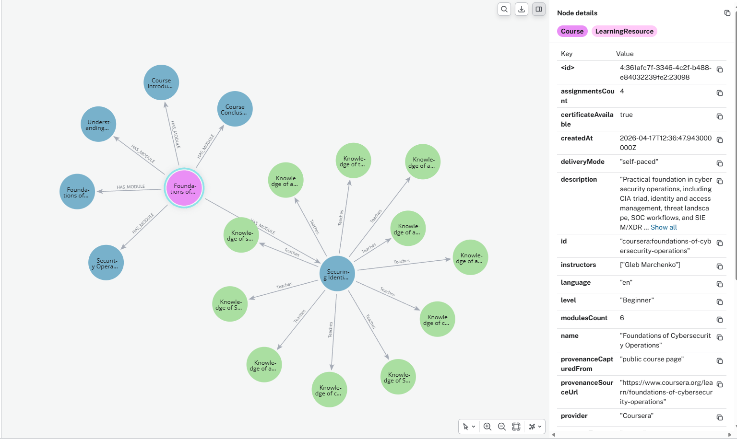
The Graph for Supporting Learning Design
Once competencies are in the graph, learning assets can be attached directly to the competency nodes they teach or assess.
What This Changes for Learning Design
🔍
Start with the gap
Query the graph for competencies a learner is missing, then retrieve the learning assets that address those specific competencies.
🧩
Multi-platform delivery
A single competency node can link to a classroom course, an online module, a simulation, and an assessment simultaneously.
📐
Blended design
Learning designers can build programs by selecting across modalities, all anchored to the same underlying competency definitions.
🤖
AI content generation
AI can draft training content — scenarios, quiz questions, objectives — directly from competency nodes, precisely aligned to the requirement.
Every Competency Node is a Connection Point to What Teaches / Assess it

Slide 25
Governance and Lifecycle Management
Example: In some instances, it takes 6- months for spreadsheet-based KSATs to be propagated to Training and Education teams after they’ve been updated. Curriculum updates can take another 6 – months which means a 1-year lag between the time a KSAT is updated and the associated courses are updated.
WITHOUT THE GRAPH
WITH THE GRAPH
✗ A KSAT is updated → every course, assessment, and job description that references it must be manually identified and reviewed
✗ No automated way to know what is affected by a change
✗ Versions of competency definitions exist in separate documents with no central tracking
✗ SME review cycles are scheduled separately from content and cannot be linked to specific changes
✗ Outdated content persists because the maintenance burden is too high
✓ A KSAT change propagates instantly, and all connected competencies and learning assets are identified automatically
✓ Versioning is managed at the node level with full metadata (created, validated by, last reviewed)
✓ SME validation cycles are built into the graph structure and tracked
✓ Impact of any update is visible before changes are applied
✓ Content lifecycle rules govern when competencies expire and must be re-reviewed
The Graph Makes Governance Faster, More Targeted, and Fully Auditable

Slide 26
Implications for International Cyber Workforce Programs
The approach described here is not specific to the U.S. DoD. Any organization with a workforce framework and a need to operationalize it at scale can apply the same methodology.
🌐
Built on Open Standards
🔧
Adaptable to Any Framework
IEEE 1484.20.3 is an international standard. A competency graph built to this model can be read by any compliant system to enable cross-national interoperability for allied workforce programs.
The methodology is framework-agnostic. Whether starting from NICE, DCWF, or a national cyber workforce taxonomy, the same graph structure and AI-generation approach applies.
📈
Scales with the Need
🤝
Human Expertise Stays Central
Smaller organizations can start with a subset of roles and expand. The graph architecture does not require a complete taxonomy before delivering value.
AI accelerates production; local subject matter experts remain in control of what is validated and approved. The methodology works with any level of AI familiarity.
Open Standards makes this approach Portable. Any Nation with a Workforce Framework can apply this Same Methodology

Slide 27
Key Take Aways
01
KSATs need atomic competencies to be usable
02
AI + human expertise = scale without sacrificing quality
03
A knowledge graph is the right data structure
High-level competency labels cannot drive training design, proficiency assessment, or skills gap analysis without a layer of specific, observable definitions beneath them.
Generative AI can produce 14,000+ competency statements that would take years to write manually. Human expert review ensures they are accurate and professionally defensible.
Neo4j's graph architecture makes relationships between workforce requirements, competencies, and learning assets explicit, queryable, and governable — in a way that spreadsheets cannot.
04
Open standards protect the investment
05
This blueprint is adaptable
Building to IEEE 1484.20.3 and the ADL Total Learning Architecture ensures portability, interoperability, and vendor independence — now and as systems evolve.
Any organization with a workforce framework can apply the same methodology. The tools are general; the approach is proven.
This is a Working Model. Not a Concept. It can be Adapted and Applied Right Now.

Slide 28
Questions and Discussion
Questions & Discussion
Brent Smith | brent@creativelearningservices.com
Sara Rahgooy | sara@creativelearnignservices.com
Website: https://www.creativelearningservices.com

