Slide 1

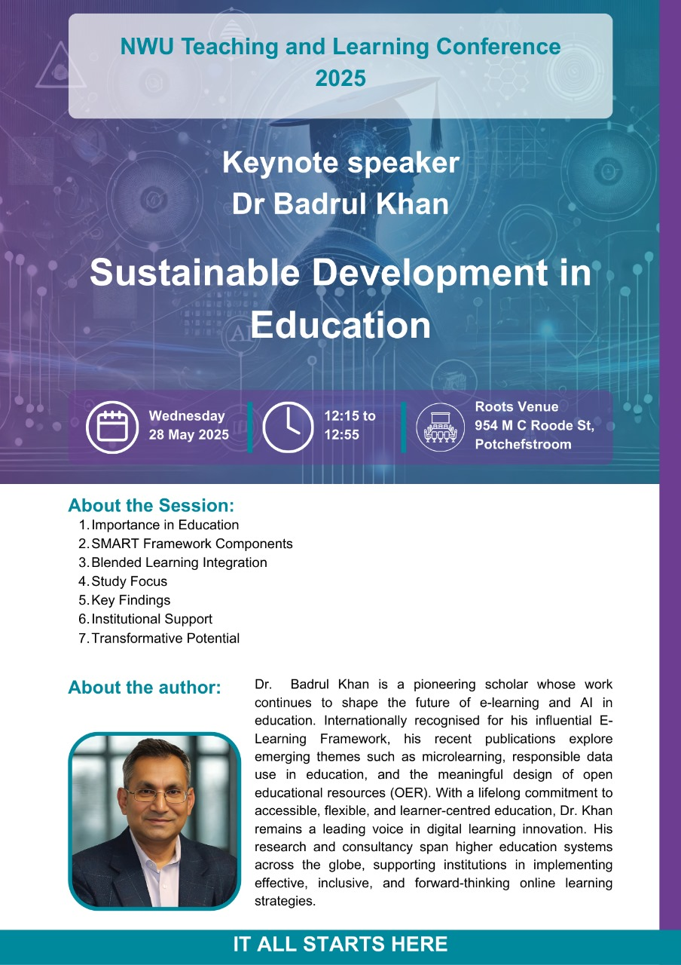
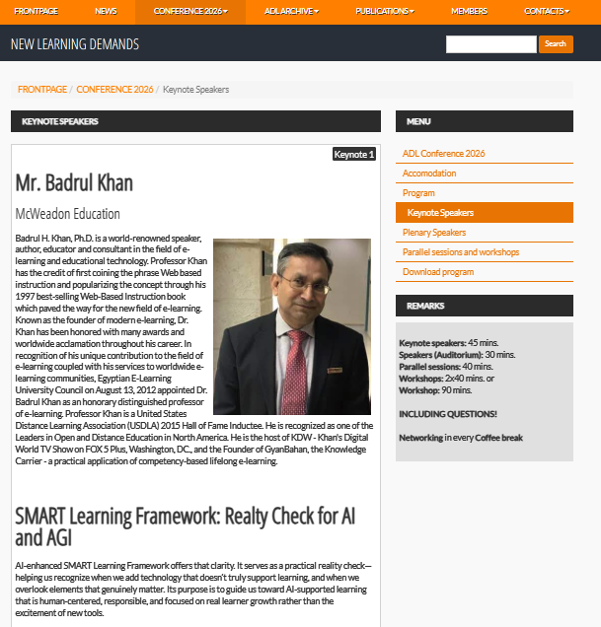

Badrul Khan, Ph.D.
BadrulKhan.com

Slide 2
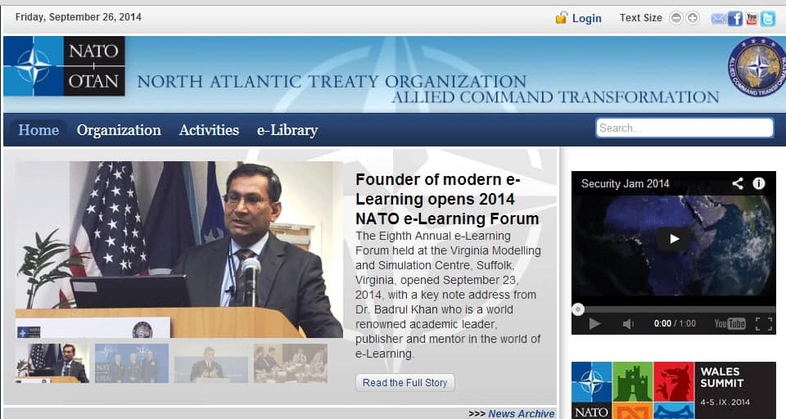
PAST EXPERIENCE with NATO and NORDIC ADL

Slide 3

My NORDIC Connection:
Anika Siddique, a niece of mine was born in Sweden plays for AIK Sweden has played for Bangladesh Girls National team.
We had dinner at her home on Sunday.

Slide 4
The Effectiveness
of AI in Learning

Slide 5
— Avoid Shiny Object Syndrome —
Understanding where NOT to invest in AI is just as important as knowing where to invest. This balanced approach helps ensure your AI strategy remains sustainable, focused, and ultimately more successful. (Badrul Khan, July 6, 2025)

Slide 6
— Challenges of AI —
AI can do a lot, but it’s not great at dealing with complicated human feelings or tough moral situations. Some things still need a real person. That’s why we have to learn when AI is actually helpful and when it’s better to rely on our own judgment, so people stay in control instead of the technology.

Slide 7
Our Responsibility as Educators
I feel that AI has the potential to be more successful in “well-defined domain of knowledge” than “ill-defined domain of knowledge.”
AI tends to work best in areas where the rules are clear and the tasks are well‑defined. It struggles much more in situations that call for nuance, context, or human judgment.

Slide 8
Our Responsibility as Educators
Therefore, it is our responsibility as educators and trainers to understand its limitations so that we do not misguide the learners!

Slide 9


James Cameron, a famous filmmaker Skeptic toward the Use of AI for Screenwriting.

Slide 10
AI: What Could Go Wrong? with Geoffrey Hinton, the “Godfather of AI”

Slide 11
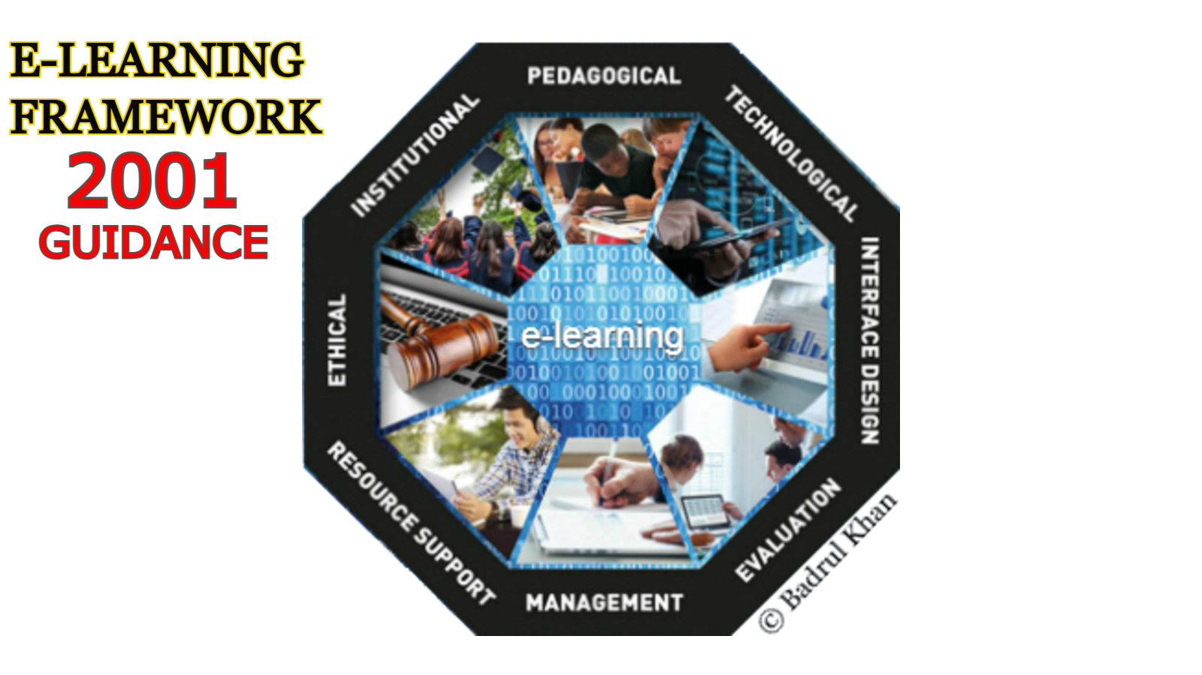

Slide 12
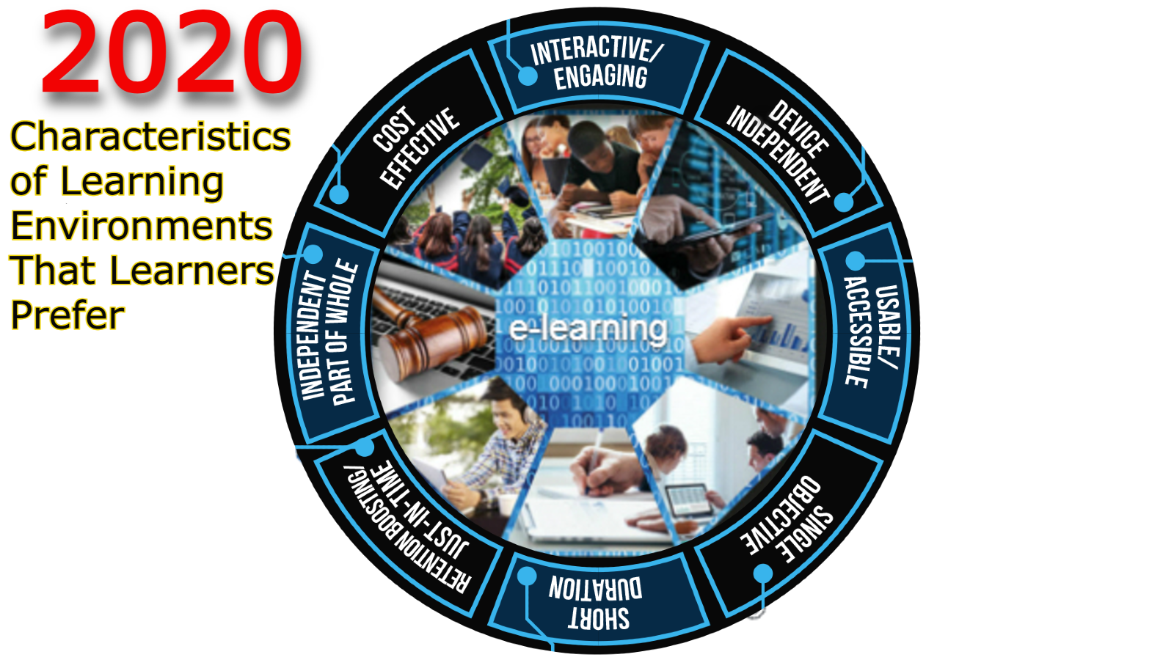

Slide 13
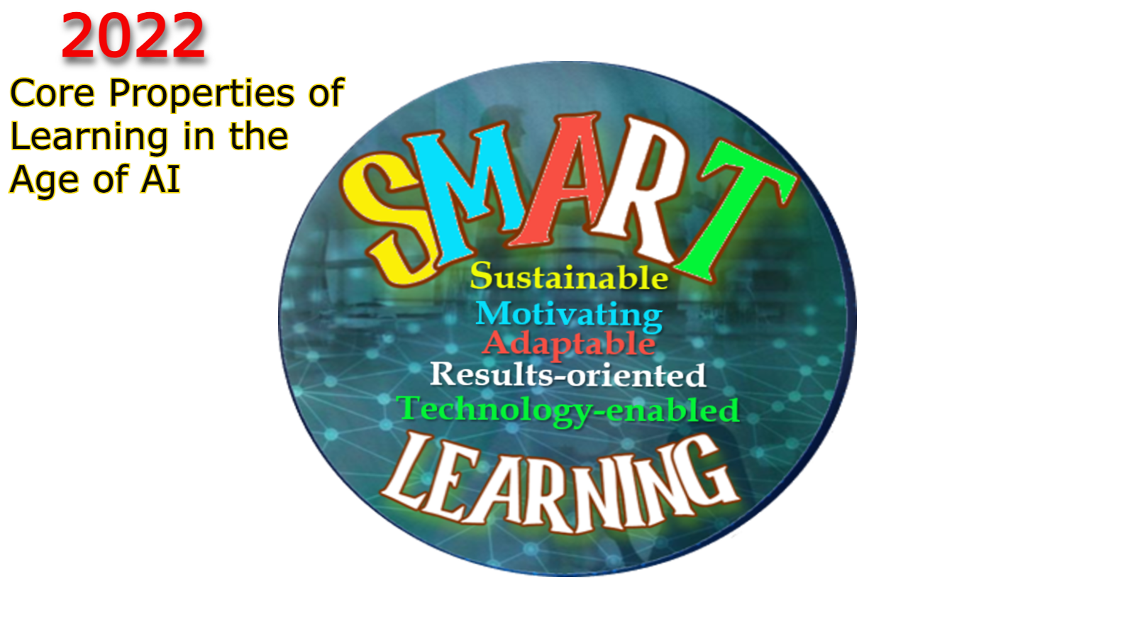

Slide 14
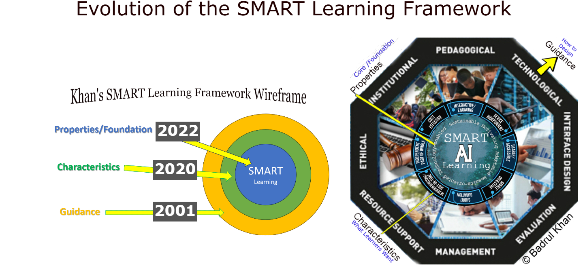

Slide 15
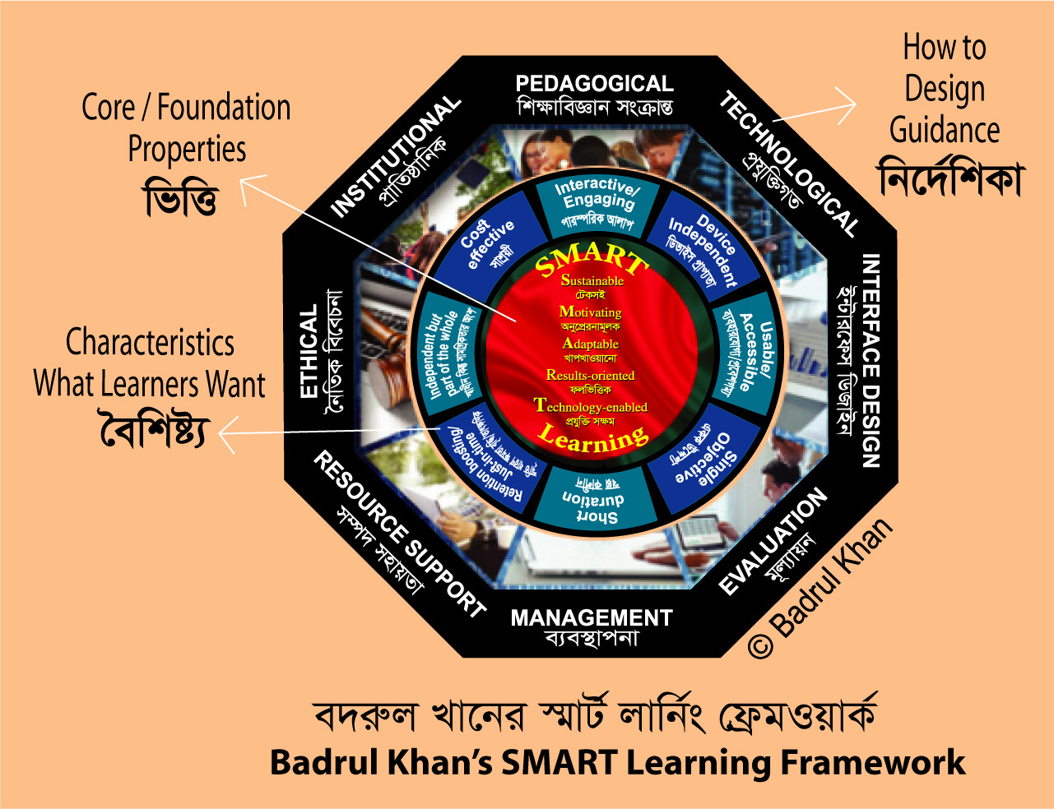

Slide 16
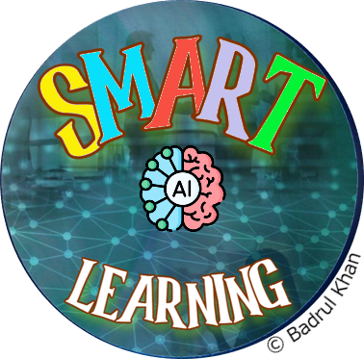
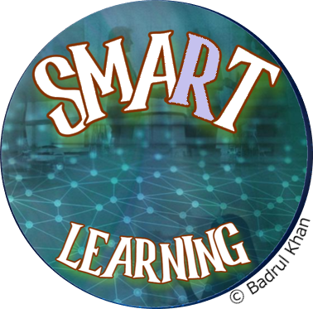
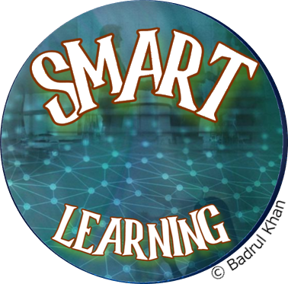
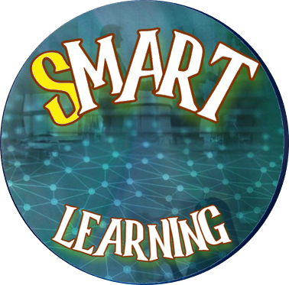
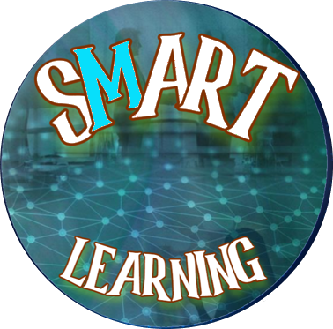
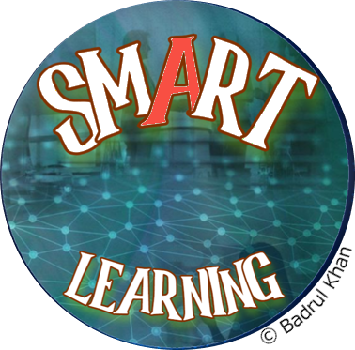
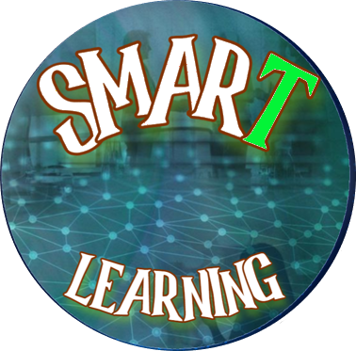
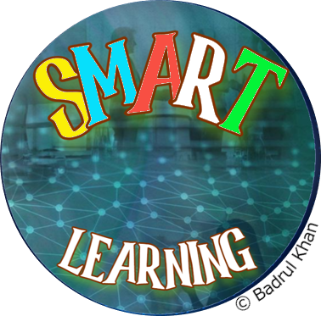
SMART LEARNING
Properties, CHARACTERISTICS and GUIDANCE
Technology-enabled
With proper digital infrastructure,
emerging technologies should
be able to enable learners to
acquire knowledge and skills
more effectively, efficiently,
comfortably, and conveniently
in a safe and secure environment.
These emerging technologies
may include advanced learning
management system,
artificial intelligence,
ChatGPT, metaverse,
virtual reality, multimedia, etc.
Adaptable
Meaningful integration of newer
technologies in education can
help learners to prepare for lifelong
learning, however, learners must
be acceptable and adaptable to
these changes. Adaptability is a
skill that can be developed over
time. It involves embracing
change, maintaining a positive
attitude, and continually
learning and growing.
Results-oriented
Goals and objectives-focused,
outcome-based, results-oriented
learning environment aim to
measure whether learners
achieve their desired
learning goals.
Motivating
Safe and goal oriented, engaging, interactive learning environments supported by rich learning
resources are always motivating
to learners.
Sustainable
Ability to retain and
apply knowledge and skills
over a long period of time
(i.e., life-long learning).
Simply “learning that sticks.”
Sustainable
Results-oriented
Adaptable
Motivating
Technology-enabled
BadrulKhan.com/smart
CORE Properties / Foundation
of SMART Learning environment

Slide 17


Slide 18
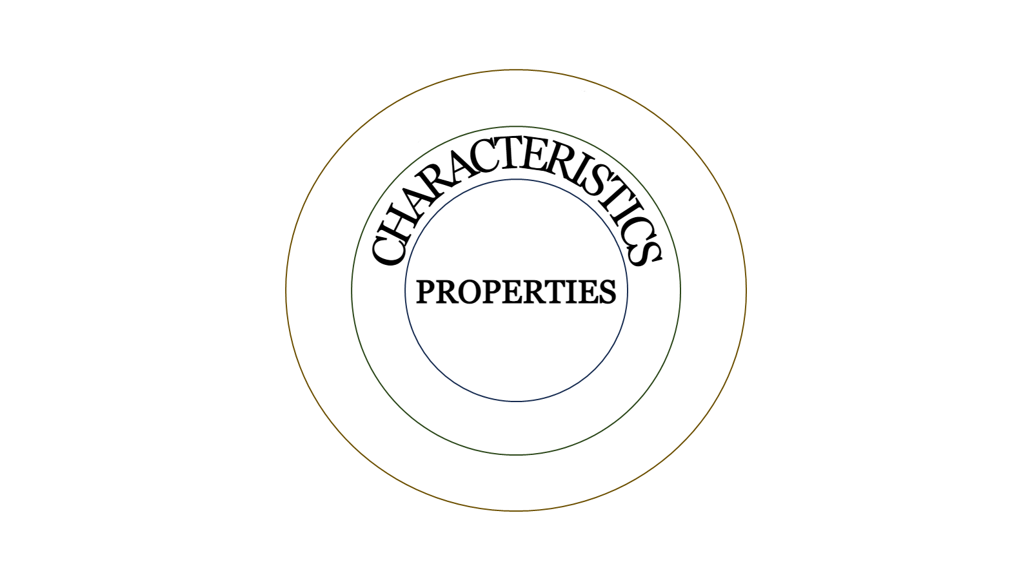
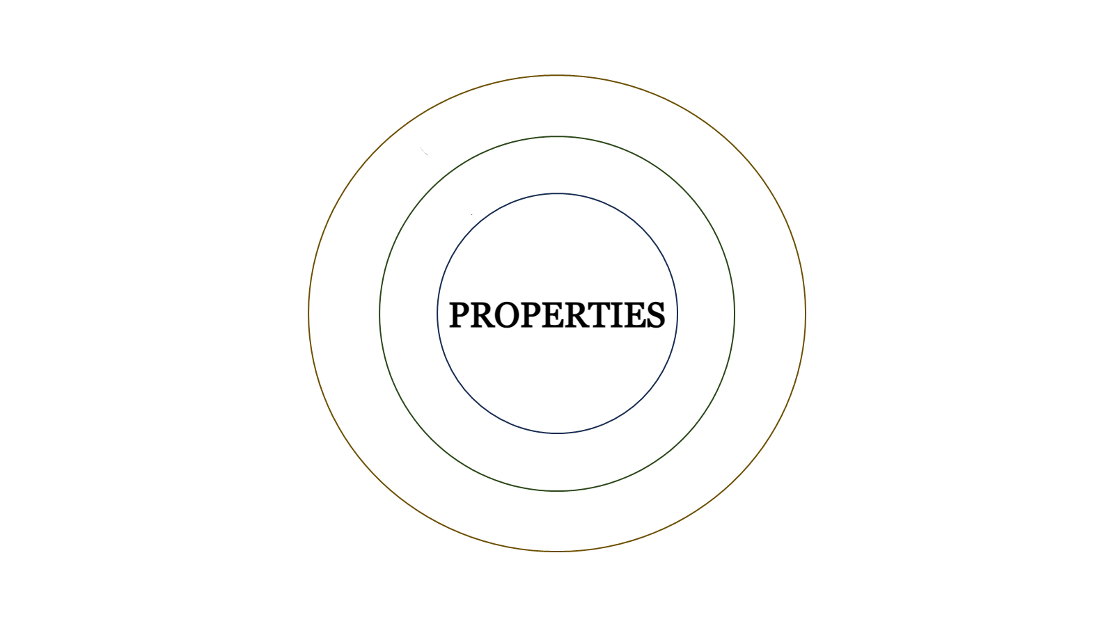



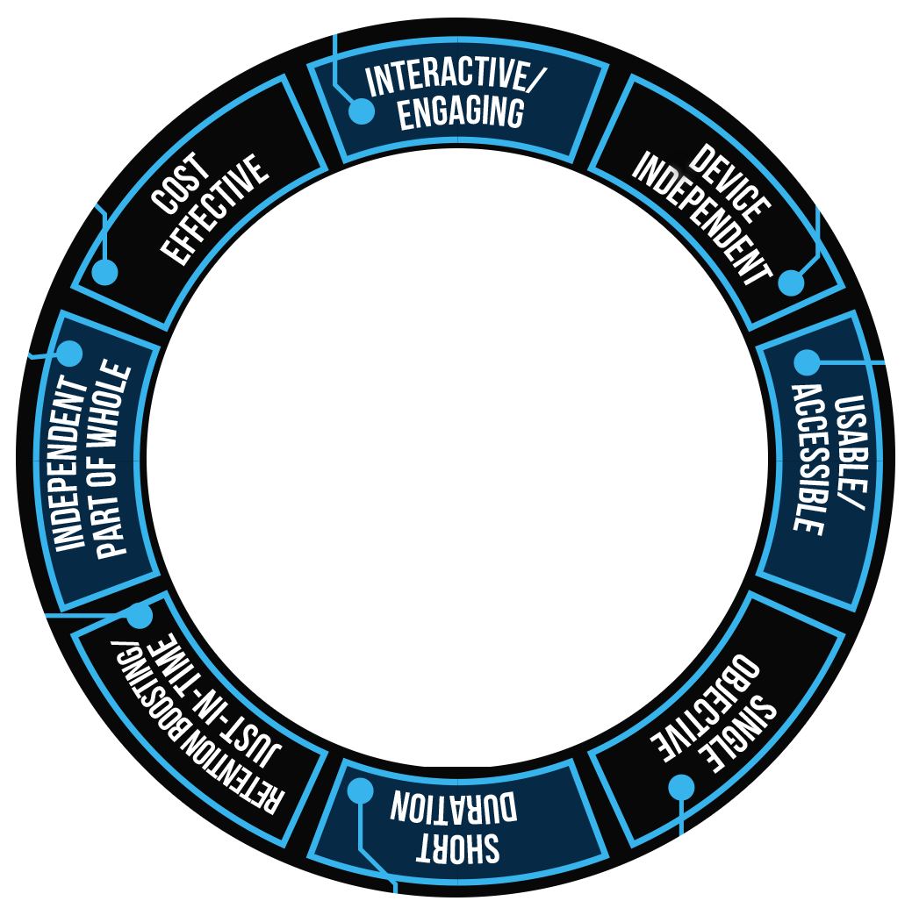

SMART LEARNING
PROPERTIES, CHARACTERISTICS and GUIDANCE
Characteristics of
Learning
Environment
Learners Need
BadrulKhan.com/smart

Slide 19


Interactive / Engaging
Interactivity keeps learners
engaged in learning with
appropriate immediate feedback.
Cost effective
In the period of digital
transformation in our society,
various learning technologies
are available to create cost
effective, meaningful flexible,
distributed learning materials.
Device Independent
In the digital world,
whatever devices
(e.g., smartphones,
tablets, and laptops)
are readily available
to learners, they
will use them to
access their courses.
Therefore, learning
should be designed to
work on multiple devices.
Independent but part of the whole
Standalone bite-sized learning
in snippets is independent but
systemically part of the whole
course therefore consistent
navigation and resources
should be considered.
Usable/Accessible
Learning materials
should be designed
in the most efficient
way so that all learners,
including individuals
with disabilities, can
easily access and use
with consistent navigation.
Learners
Want
Retention boosting
Delivering content
meaningfully in bite-sized
chunks reduces information
overload, improves attention
span, increases motivation and
engagement.
Learners can gain some important
knowledge quickly, at the moment of
need, thereby, boost knowledge retention.
Short duration
In the digital world,
learners’ attention spans
are becoming shorter,
therefore, microlearning
or learning in snippets
in short duration are
attractive and motivational
to learners.
Single Objective Focused
A single objective keeps the
learning more focused on
providing learners with
measurable outcomes; boosts
knowledge transfer and retention.
Notes:
Interactive/Engaging. Interactivity keeps learners engaged in learning with appropriate immediate feedback.
Device Independent. In the digital world learning materials and experiences should be designed to work across multiple devices and platforms (e.g., smartphones, tablets, and laptops) to take advantage of the tools available to learners.
Usable/Accessible. Learning materials should be designed in the most efficient way so all learners, including individuals with disabilities, can easily access and use them. Navigation should be intuitive and consistent throughout.
Single Objective. Learning experiences should be broken up into focused, single objective lessons with measurable outcomes to boost knowledge transfer and retention and keep learners focused.
Short Duration. In the digital world, learners’ attention spans are becoming shorter, therefore, microlearning or learning in snippets of short duration are more attractive to learners.
Retention Boosting/Just-in-time. Delivering content meaningfully in bite-sized chunks reduces information overload, improves attention span, increases motivation and engagement. Learners can gain important knowledge quickly, at the moment of need, thereby, boost knowledge retention.
Independent/Part of the Whole. Standalone bite-sized learning snippets can be developed to be consumed independently, but systemically; they are part of a whole (i.e. part of a larger instructional unit). Therefore, when developing independent learning objects, consistent navigation and resources should be considered.
Cost Effective. During this period of rapid digital transformation, various new and emerging learning technologies are becoming available to make it easier to create cost effective, meaningful, flexible, distributed learning materials.

Slide 20


SMART LEARNING
PROPERTIES, CHARACTERISTICS and GUIDANCE
How to Provide Guidance in
The Design of Smart Learning?

Slide 21
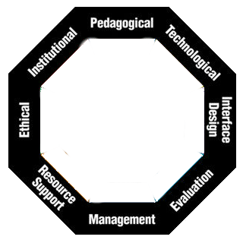
SMART LEARNING
PROPERTIES, CHARACTERISTICS and GUIDANCE
How to Provide Guidance in
the Design of Smart Learning?

Slide 22
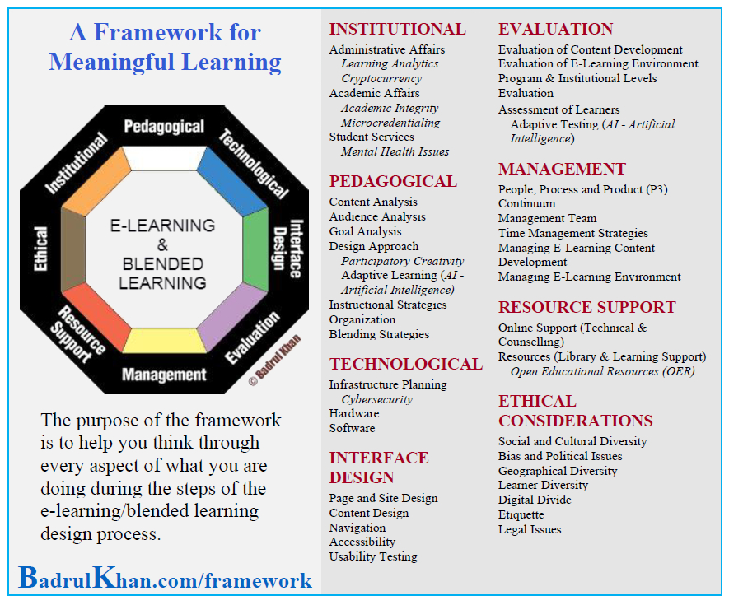

Slide 23


Data Center
Environmental Sustainability

Slide 24
Technological and Ethical Consideration
Environmental Sustainability means paying attention to the ecological impact of running AI and its supporting data centers.
It highlights issues like how much electricity these systems use, how much carbon they emit, and how much water and other resources are required to cool and operate the hardware.
It also implies designing and choosing AI and infrastructure in ways that reduce this footprint—for example, using more efficient models, cleaner energy sources, and responsible cooling and resource‑management practices

Slide 26
Pedagogical and Evaluation
Adaptive learning and adaptive testing in AI in learning both mean that the system “adjusts as you go” so each learner gets a better fit.
Adaptive learning (Pedagogical) changes the lesson (what comes next) based on how you are doing, giving easier, harder, or different explanations as needed.
Adaptive testing (Evaluation) changes the questions on a test based on each answer, so it can find your level with fewer, better-targeted questions

Slide 27
Professional Development in AI Training
Insufficient training for AI use

Slide 28
Institutional and Management
Teachers and students are encouraged or required to use AI, but management provides little structured training, guidance, or ongoing support, resulting in misuse, over‑reliance, or avoidance.​
Possible research question:
How does a structured AI professional development and support program for teachers and students affect the quality, safety, and pedagogical value of AI use in a smart learning system?

Slide 29
Ethical AI Support in E‑Learning Interfaces
Ethical AI Support in E‑Learning Interfaces

Slide 30
Interface Design, Resource Support and Ethical Consideration
AI in a learning platform should be easy to see, easy to understand, and under the learner’s control, while following strong ethical principles so learners always feel supported and respected.

Slide 31
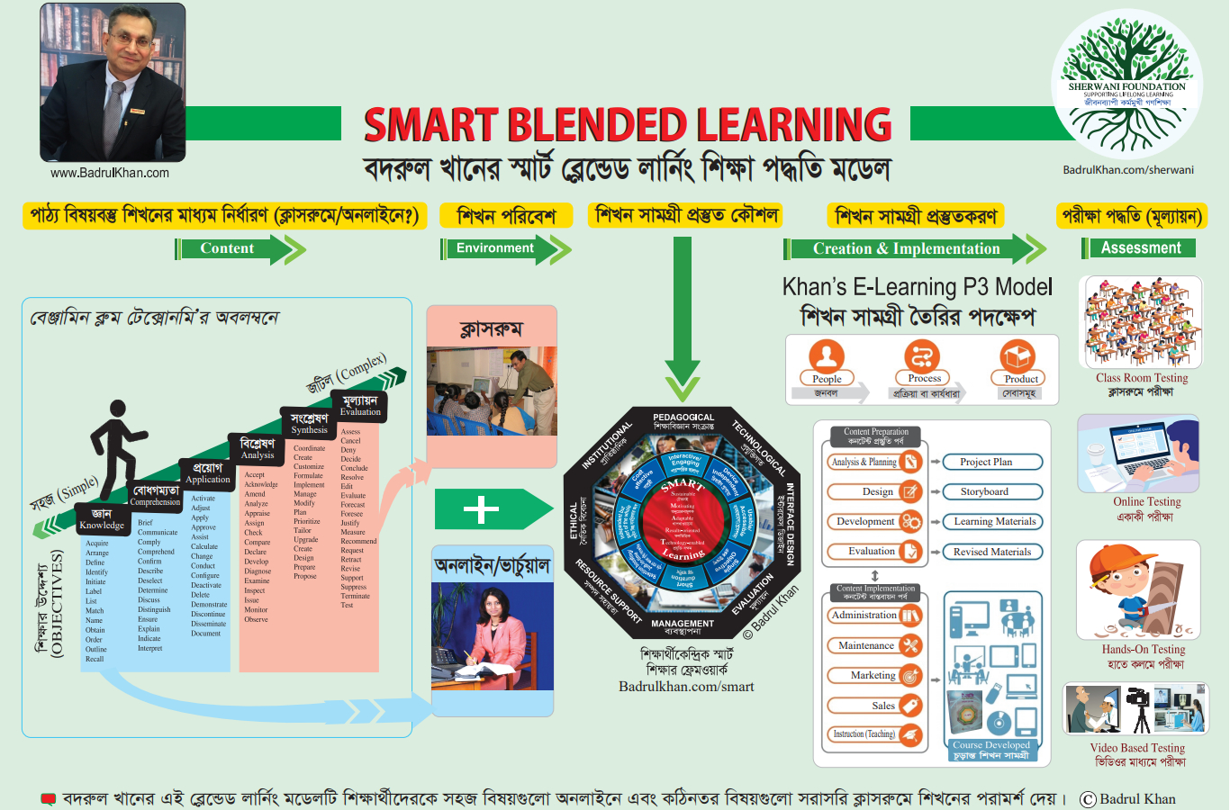

Slide 36
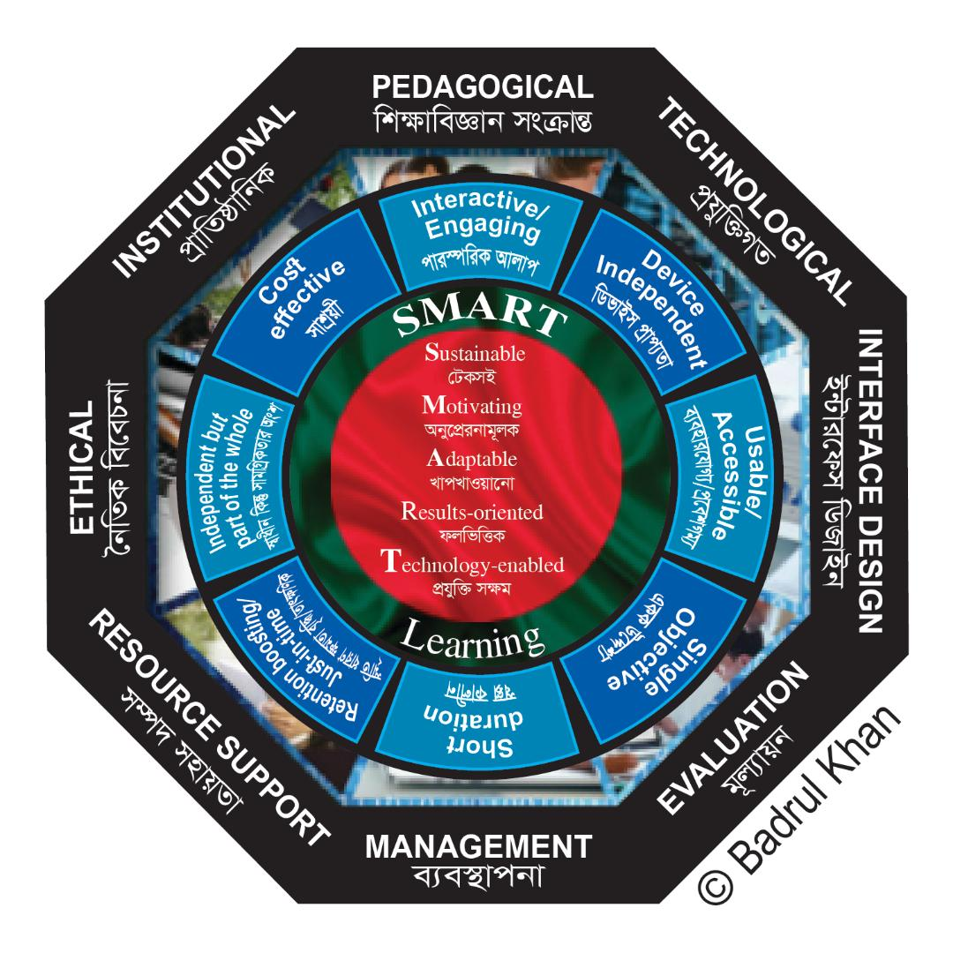

Slide 41


Slide 42
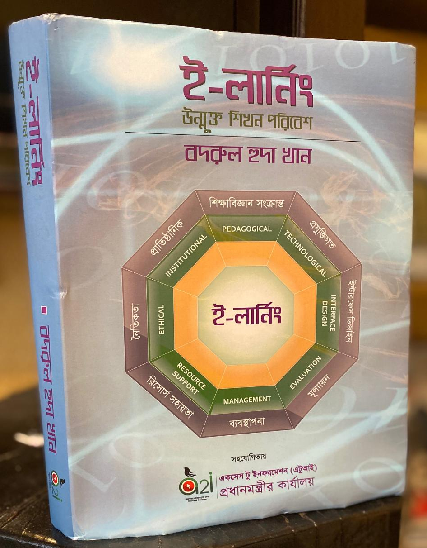


Slide 43
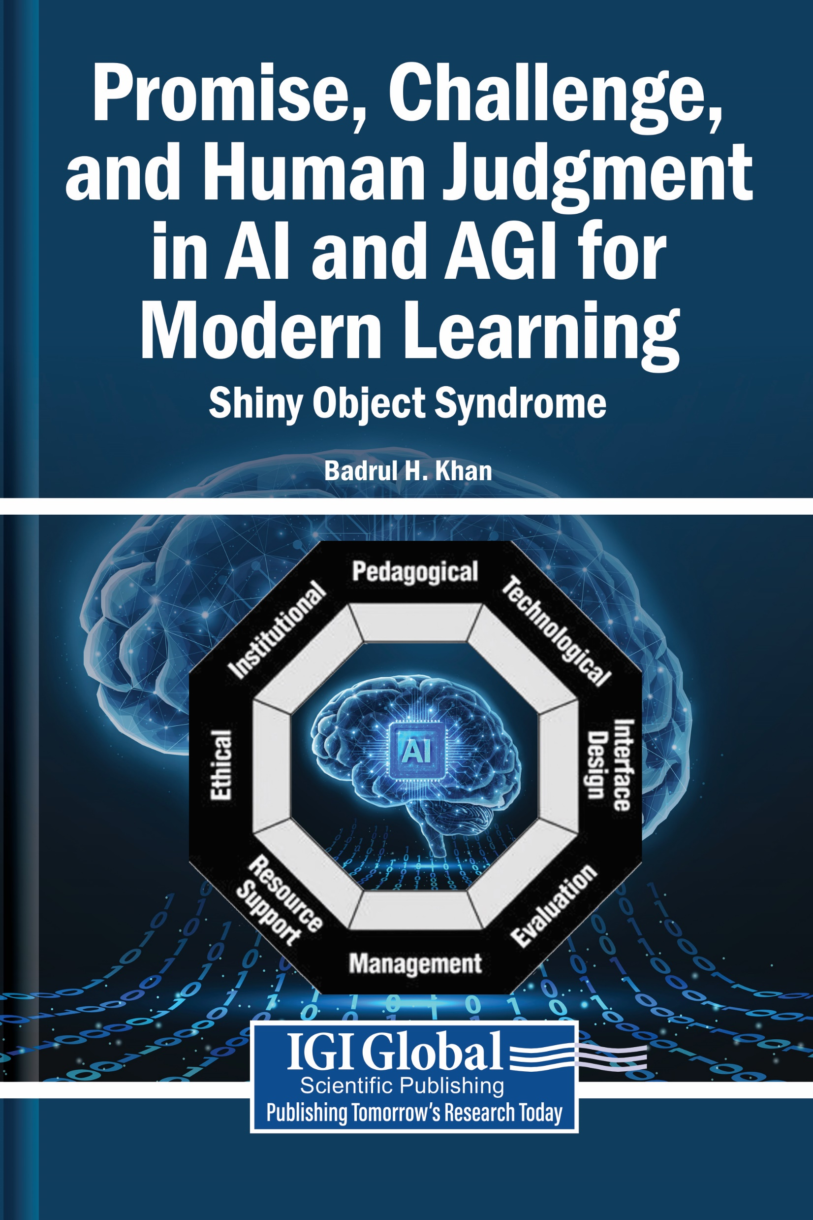

Slide 44
THANK YOU
Badrul Khan, Ph.D.
BadrulKhan.com

